Slide 1
List of _x000b_References
© A+ Computer Science - www.apluscompsci.com

Slide 2
What is
a list?
© A+ Computer Science - www.apluscompsci.com

Slide 3
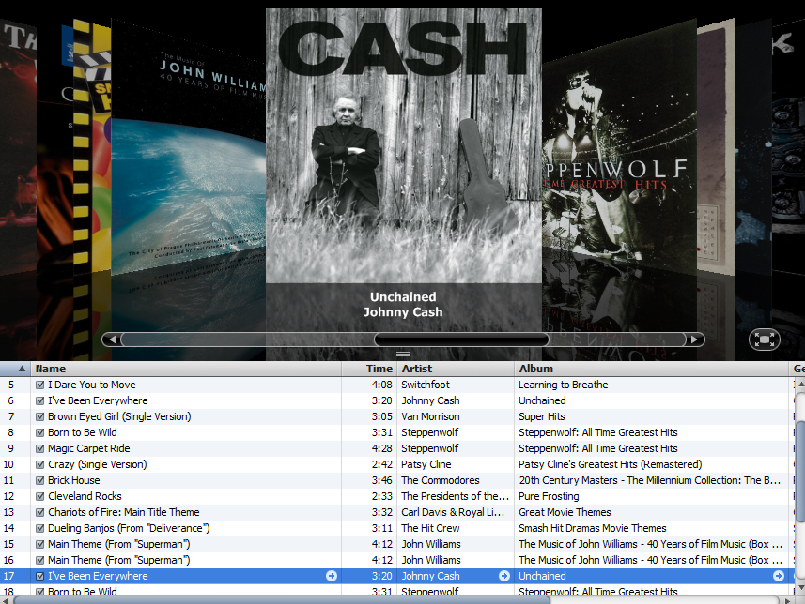

© A+ Computer Science - www.apluscompsci.com

Slide 4
List _x000b_References
© A+ Computer Science - www.apluscompsci.com

Slide 5
List References
List<SomeClass> list;
list
null
null
nothing
list is a reference to some list
© A+ Computer Science - www.apluscompsci.com
Notes:
A reference variable is used to store the location of an Object. In most situations, a reference stores the actual memory address of an Object.
list stores the location / memory address of an ArrayList.

Slide 6
ArrayList Instantiation
new ArrayList<SomeClass>();
0x213
[]
ArrayLists are Objects.
© A+ Computer Science - www.apluscompsci.com

Slide 7
ArrayList
List<SomeClass> list;
list = new ArrayList<SomeClass>();
list
0x213
0x213
[]
list is a reference to an ArrayList.
© A+ Computer Science - www.apluscompsci.com
Notes:
A reference variable is used to store the location of an Object. In most situations, a reference stores the actual memory address of an Object.
list stores the location / memory address of an ArrayList.

Slide 8
List Of_x000b_References
© A+ Computer Science - www.apluscompsci.com

Slide 9
public class Dog
{
private int age;
private String name;
public Dog( String n, int a ) {
age = a;
name = n;
}
public int getAge() {
return age;
}
public String getName() {
return name;
}
public String toString() {
return "Dog - " + name + " " + age;
}
}
Basic_x000b_Class
© A+ Computer Science - www.apluscompsci.com
Notes:
Classes are used to store related methods and variables.

Slide 10
Open
Dog.java
DogRunner.java
© A+ Computer Science - www.apluscompsci.com

Slide 11
List of References
List<Dog> ray;
ray = new ArrayList<Dog>();
ray.add( new Dog( "fred", 11) );
ray.add( new Dog( "ann", 21) );
System.out.println( ray );
OUTPUT
[Dog - fred 11, Dog - ann 21]
© A+ Computer Science - www.apluscompsci.com
Notes:
Lists / ArrayLists can store references to objects. This enables each spot in the List / ArrayList to house more than just a single value. Each spot can house multiple variables and methods all of which would be contained in a class.

Slide 12
List of References
ray.add( new Dog( "fred", 11) );
ray.add( new Dog( "ann", 21) );
ray.add( new Dog( "bob", 4) );
0 1 2
ray
0x12 | 0x32 | 0xD2
Dog
11
Dog
21
Dog
4
© A+ Computer Science - www.apluscompsci.com
Notes:
Lists / ArrayLists can store references to objects. This enables each spot in the List / ArrayList to house more than just a single value. Each spot can house multiple variables and methods all of which would be contained in a class.

Slide 13
Open
DoggiesRunner.java
© A+ Computer Science - www.apluscompsci.com

Slide 14
More List s_x000b_of References
© A+ Computer Science - www.apluscompsci.com

Slide 15
ArrayList w/User Classes
public class Creature implements Comparable {
private int size;
//checks to see if this Creature is big – size > x
public boolean isBig()
//implementation details not show
public boolean equals(Object obj)
//implementation details not show
public int compareTo(Object obj)
//implementation details not show
//other methods and constructors not shown
}
© A+ Computer Science - www.apluscompsci.com

Slide 16
ArrayList w/User Classes
ArrayList<Creature> creatures;
creatures = new ArrayList<Creature>();
creatures.add(new Creature(4));
creatures.add(new Creature(9));
creatures.add(new Creature(1));
0 1 2
creatures
0x12 | 0x32 | 0xD2
Creature
4
Creature
9
Creature
1
© A+ Computer Science - www.apluscompsci.com

Slide 17
ArrayList w/User Classes
ArrayList<Creature> creatures;
creatures = new ArrayList<Creature>();
creatures.add( new Creature(41) );
creatures.add( new Creature(91) );
creatures.add( new Creature(11) );
out.println( creatures.get(0) );
creatures.get(0).setSize(79);
out.println( creatures.get(0) );
out.println( creatures.get(2) );
out.println( creatures.get(1).isBig() );
OUTPUT
41
79
11
true
© A+ Computer Science - www.apluscompsci.com
Notes:
Creatures is an ArrayList that stores reference to Creature objects.
In this example, creatures stores the addresses / locations of 3 Creature objects.
creatures.get(1).isBig() accesses the reference at spot 1 and calls the isBig() method on the creature to which the ArrayList is referring.

Slide 18
ArrayList w/User Classes
creatures.get(0)
.
setSize(7);
0x242
0x242
Creature
What does the . dot do?
What does this return?
The . dot grants access to the Object at the stored address.
© A+ Computer Science - www.apluscompsci.com
Notes:
Creatures.get(0) returns the address / location of a Creature object. Applying a . dot to a reference grants you access to the object referred to by the reference. .setSize() is a Creature method that changes the size property of the Creature.

Slide 19
ArrayList w/User Classes
/* method countBigOnes should return the count of
big creatures - use the isBig() Creature method
*/
public int countBigOnes()
{
int cnt = 0;
//for each loop
//if statement
//increase cnt by 1
return cnt;
}
© A+ Computer Science - www.apluscompsci.com
Notes:
The countBigOnes method will go through all of the Creature objects to find out how many of them are big.
The for each loop is not required, but it sure makes writing this type of method much easier.
This is a classic example of a linear search.
The AP Free Response questions always ask students to write this style of code every single year.

Slide 20
Open
creature.java
herd.java
herdrunner.java
Complete the code
© A+ Computer Science - www.apluscompsci.com

Slide 21
AutoBoxing
AutoUnboxing
© A+ Computer Science - www.apluscompsci.com

Slide 22
Box/Unbox
primitive | object
byte | Byte
short | Short
int | Integer
long | Long
float | Float
double | Double
char | Character
boolean | Boolean
== | .equals()
© A+ Computer Science - www.apluscompsci.com
Notes:
For each of the primitive types, there is a corresponding wrapper class.
int has a corresponding wrapper class named Integer.
int stores a non-decimal value.
Integer stores the location / memory address of an Integer Object which stores an int value.
double has a corresponding wrapper class named Double.
double stores decimal and non-decimal values.
Double stores the location / memory address of a Double Object which stores a double value.

Slide 23
Box/Unbox
Before Java 5 added in autoboxing
and autounboxing, you had to
manually wrap primitives.
Integer x = new Integer(98);
int y = 56;
x= new Integer(y);
© A+ Computer Science - www.apluscompsci.com
Notes:
Before autoboxing and autounboxing, a reference could only refer to a primitive if a Wrapper class was instantiated and the primitive passed to the constructor.

Slide 24

Box/Unbox
Java now wraps automatically.
Integer numOne = 99;
Integer numTwo = new Integer(99);
=99;
=new Integer(99);
These two lines are equivalent.
© A+ Computer Science - www.apluscompsci.com
Notes:
Integer numOne = 99; is equivalent to
Integer numOne = new Integer(99);
With the introduction of Java 5, the new Integer() Object instantiation code happens in the background. Java takes care of these details, but does not show the work.

Slide 25
Box/Unbox
Java now wraps automatically.
Double numOne = 99.1;
Double numTwo = new Double(99.1);
=99.1;
=new Double(99.1);
These two lines are equivalent.
© A+ Computer Science - www.apluscompsci.com
Notes:
Double numOne = 99; is equivalent to
Double numOne = new Double(99);
With the introduction of Java 5, the new Double() Object instantiation code happens in the background. Java takes care of these details, but does not show the work.

Slide 26
Box/Unbox
Before Java 5 added in autoboxing
and autounboxing, you had to
manually unwrap references.
Integer ref = new Integer(98);
int y = ref.intValue();
© A+ Computer Science - www.apluscompsci.com
Notes:
Before autoboxing and autounboxing, a reference value could only be stored in a primitive if the corresponding reference get method was called to retrieve the primitive value from the reference.

Slide 27
Box/Unbox
Java now unwraps automatically.
Integer num = new Integer(3);
int prim = num.intValue();
out.println(prim);
prim = num;
out.println(prim);
prim=num.intValue();
prim=num;
These two lines are equivalent.
OUTPUT
3
3
© A+ Computer Science - www.apluscompsci.com
Notes:
Integer numOne = new Integer(99);
int primInt = numOne; is equivalent to
int primInt = numOne.intValue();
With the introduction of Java 5, the intValue() method call happens in the background. Java takes care of these details, but does not show the work.

Slide 28
Box/Unbox
Double dub = 9.3;
double prim = dub;
out.println(prim);
int num = 12;
Integer big = num;
out.println(big.compareTo(12));
out.println(big.compareTo(17));
out.println(big.compareTo(10));
OUTPUT
9.3
0
-1
1
© A+ Computer Science - www.apluscompsci.com
Notes:
Before autoboxing and autounboxing, a reference could only refer to a primitive if a Wrapper class was instantiated and the primitive passed to the constructor.
Before autoboxing and autounboxing, a reference value could only be stored in a primitive if the corresponding reference get method was called to retrieve the primitive value from the reference.
With the introduction of Java 5, the wrapping and unwrapping / boxing and unboxing happens in the background. Java takes care of these details, but does not show the work.

Slide 29
Open
autoboxunbox.java
© A+ Computer Science - www.apluscompsci.com

Slide 30
new for loop
ArrayList<Integer> ray;
ray = new ArrayList<Integer>();
//add some values to ray
int total = 0;
for(Integer num : ray)
{
//this line shows the AP preferred way
//it shows the manual retrieval of the primitive
total = total + num.intValue();
//the line below accomplishes the same as the line above
//but, it uses autounboxing to get the primtive value
//total = total + num;
}
out.println(total);
OUTPUT153
© A+ Computer Science - www.apluscompsci.com
Notes:
The new for loop is great to print out Arrays and Collections. The new for loop extracts an item from ray each time it iterates. The new for loop is an iterator based loop. Once the loop reaches the end of ray, it stops iterating.

Slide 31
Open
foreachloopone.java
foreachlooptwo.java
© A+ Computer Science - www.apluscompsci.com

Slide 32
Continue work
on Lab 16
© A+ Computer Science - www.apluscompsci.com

